Slide 1
Logistics dataset

Slide 2
Introduction
As a logistics analyst for our pharmaceutical company, I have compiled and analyzed data from our logistics and pharma online portals to provide a comprehensive overview of our shipment performance.
This analysis includes a detailed assessment of on-time versus late shipments, with a focus on country-wise summaries to identify regions with performance issues. Additionally, I have conducted a cost analysis comparing product costs to freight costs to uncover potential inefficiencies and opportunities for cost reduction.
Based on these findings, I have developed actionable recommendations to optimize routes, enhance cost efficiency, and improve our alignment with forwarders. The insights will be presented through a detailed Power BI report and a narrative storyboard to ensure clarity for all members of the leadership team, including those without direct access to analytical tools.

Slide 3
Objectives:
The primary objectives are:
On-Time vs. Late Shipment Analysis
Country-Wise Summary
Product Cost vs. Freight Cost Analysis
Forwarders Performance Analysis

Slide 4
Data Preparation:
Merge Datasets:
Combine the Logistics Data with the Product Cost Per EA data using the product number as the key.
Data Cleaning:
Ensure there are no missing values, outliers, or inconsistent data formats. Check the date formats, numerical consistency (e.g., freight cost, product cost).

Slide 5
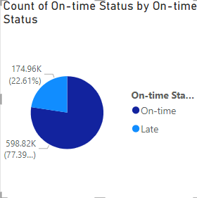
On-Time vs. Late Shipment Analysis:
The "On-time" status is significantly more prevalent than the "Late" status, indicating a relatively high on-time performance.

Slide 6
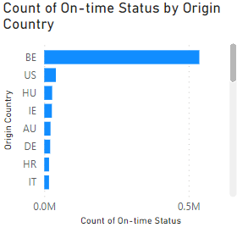
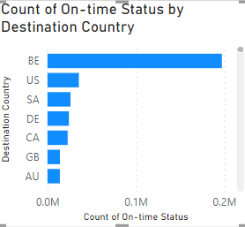
Country-Wise Summary:
There's a notable difference in on-time performance between countries. Belgium stands out as having a significantly higher count compared to others.

Slide 7
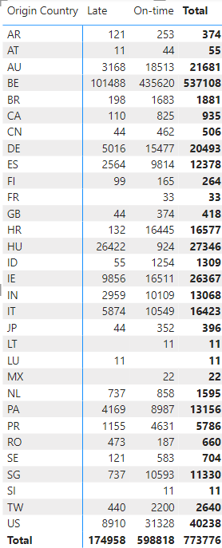
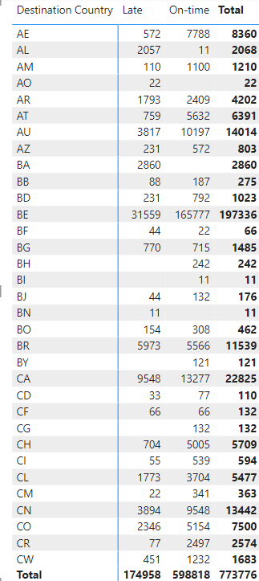
Country-Wise Summary:

Slide 8
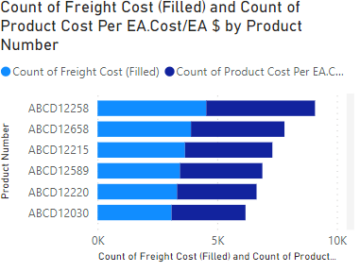
Product Cost vs. Freight Cost Analysis:
.
.
There's a noticeable difference in both freight cost and product cost across the various product numbers. Some products have significantly higher counts than others for both metrics.
There appears to be a general trend where products with higher freight costs also tend to have higher product costs.

Slide 9
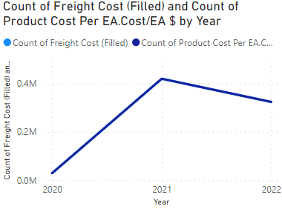
Product Cost vs. Freight Cost Analysis:
The chart reveals a substantial increase in freight costs in 2021, followed by a slight decline in 2022. This could be attributed to factors like supply chain disruptions, fuel prices, or demand fluctuations.
The consistent increase in product costs over the three years suggests rising production expenses or material costs.

Slide 10
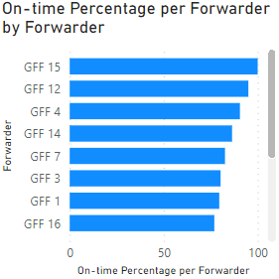
Forwarders Performance Analysis:
There's a noticeable difference in on-time performance between forwarders.
GFF 15 exhibits the highest on-time percentage.

Slide 11
Recommendations.
.
Forwarders with lower on-time percentages could benefit from analyzing their operations to identify areas for improvement and enhance their performance.
Optimize delivery routes to reduce travel time and fuel consumption.
Implement real-time shipment tracking to monitor progress and address delays proactively.
Implement inventory management strategies to reduce stock levels and transportation requirements

Slide 12
Thank you

